Slide 1
CSE 226 Multiplexers
United International University

Slide 2
Problems
Implement an 8-to-1 MUX using only one 74153 IC and a single inverter, 2-input OR gate and 2-input AND gate.
Implement F(A, B, C, D) = ∑ (0, 1, 3, 4, 8, 9, 15) using your designed Mux in terms of A

Slide 3
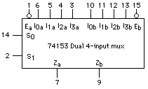
Diagram of 74153 Dual 4-1 Mux

Slide 4
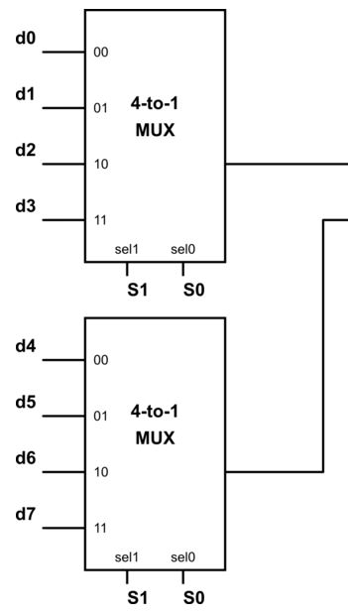
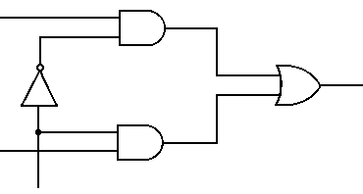
Logic Diagram for 8-to-1 Mux from 4-to-1 Mux
S2

Slide 5
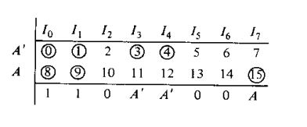
Implement F(A, B, C, D) = ∑ (0, 1, 3, 4, 8, 9, 15) using your designed Mux in terms of A
Solution: Select B, C and D as selection bits. A is connected as input.

Slide 6
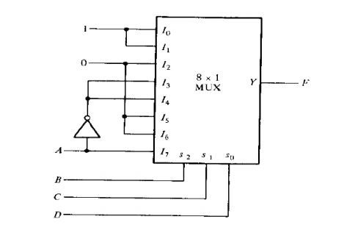
Logic Diagram of Function Implementation

Slide 7
Writing Report
What is 74153 ? Show its block diagram.
Show the complete implementation of 8-to-1 Mux with 4-to-1 Mux
Implement F(A, B, C, D) = ∑ (3, 8, 12) using your designed Mux in terms of C
Show the steps of the function implementation.
Show the complete implementation with diagram

